Slide 1
VIT University
School of Computer Science Engineering
SQL in Practical Way
By
Dr. Ravi Verma

Slide 2
Learning from Todays Session
This session will explain about the various SQL operations Like How we can perform Insertion, Deletion and Updation operation on any database.
Students will be able to learn :
Perform different database operations through various database languages like DDL,DML,DCL etc.

Slide 3
Contents

Slide 4
Contents

Slide 5
What is DDL in SQL?
DDL allows you to create SQL statements to make operations with database data structures (schemas, tables etc.).
These are SQL DDL commands list and examples:
CREATE
DROP
ALTER
RENAME
TRUNCATE

Slide 6

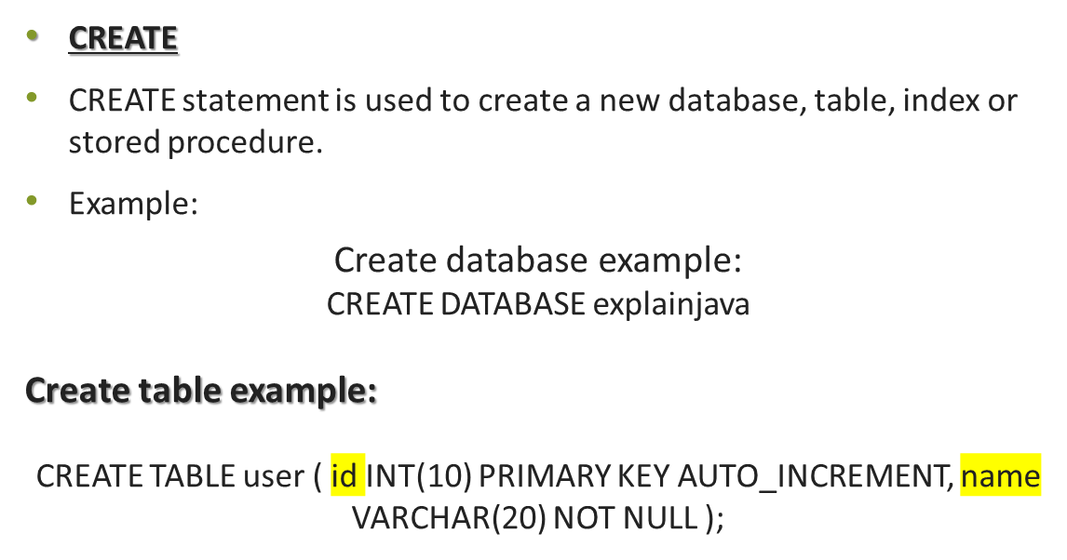
DDL Commands

Slide 7
DDL Commands Cont..
DROP
DROP statement allows you to remove database, table, index or stored procedure.
Drop database example:
DROP DATABASE explainjava;
Drop table example:
DROP TABLE user;

Slide 8
DDL Commands Cont..
ALTER
ALTER is used to modify existing database data structures (database, table).
Alter table example:
ALTER TABLE user ADD COLUMN lastname VARCHAR(20) NOT NULL;

Slide 9
DDL Commands Cont..
RENAME
RENAME command is used to rename SQL table.
Rename table example:
RENAME TABLE user TO student;

Slide 10
DDL Commands Cont..
TRUNCATE
TRUNCATE operation is used to delete all table records.
Logically it’s the same as DELETE command.
Example:
TRUNCATE student;

Slide 11
DDL Commands Cont..
Differences between DELETE and TRUNCATE commands are:
TRUNCATE is really faster
TRUNCATE cannot be rolled back

Slide 12
What is DML in SQL?
DML is a Data Manipulation Language, it’s used to build SQL queries to manipulate (select, insert, update, delete etc.) data in the database.
This is DML commands list with examples:
SELECT
INSERT
UPDATE
DELETE

Slide 13
DML Commands
SELECT
SELECT query is used to retrieve a data from SQL tables.
Example:
SELECT * FROM student;

Slide 14
DML Commands Cont..
INSERT
INSERT command is used to add new rows into the database table.
Example:
INSERT INTO student (name, lastname) VALUES ('Dmytro', 'Shvechikov');

Slide 15
DML Commands Cont..
UPDATE
UPDATE statement modifies records into the table.
Example:
UPDATE student SET name = 'Dima' WHERE lastname = 'Shvechikov’;

Slide 16
DML Commands Cont..
DELETE
DELETE query removes entries from the table.
Example:
DELETE FROM student WHERE name = 'Dima';

Slide 17
What is DCL in SQL?
DCL a Data Control Language.
Its commands are responsible for access restrictions inside of the database.
Let’s take a look at DCL statements definitions.
GRANT
REVOKE

Slide 18
DCL Commands Cont..
GRANT
GRANT command gives permissions to SQL user account.
For example, I want to grant all privileges to ‘explainjava’ database for user ‘dmytro@localhost’.
Let’s create a user first:
CREATE USER 'dmytro'@'localhost' IDENTIFIED BY '123';
Then I can grant all privileges using GRANT statement:
GRANT ALL PRIVILEGES ON explainjava.* TO 'dmytro'@'localhost';
and we have to save changes using FLUSH command:
FLUSH PRIVILEGES;

Slide 19
DCL Commands Cont..
REVOKE
REVOKE statement is used to remove privileges from user accounts.
Example:
REVOKE ALL PRIVILEGES ON explainjava.* FROM 'dmytro'@'localhost’;
and save changes:
FLUSH PRIVILEGES;

Slide 20
What is TCL in SQL?
TCL is a Transaction Control Language.
Its commands are used to manage transactions in SQL databases.
This is TCL commands list:
START TRANSACTION
COMMIT
ROLLBACK

Slide 21
TCL Commands Cont..
START TRANSACTION (BEGIN, BEGIN WORK)
START TRANSACTION is used to start a new SQL transaction.
BEGIN and BEGIN WORK are aliases for START TRANSACTION.
Example:
START TRANSACTION;

Slide 22
TCL Commands Cont..
COMMIT
As a mentioned above COMMIT command finishes transaction and stores all changes made inside of a transaction.
Example:
START TRANSACTION; INSERT INTO student (name, lastname) VALUES ('Dmytro', 'Shvechikov'); COMMIT;

Slide 23
TCL Commands Cont..
ROLLBACK
ROLLBACK statement reverts all changes made in the scope of transaction.
Example:
START TRANSACTION; INSERT INTO student (name, lastname) VALUES ('Dmytro', 'Shvechikov'); ROLLBACK;

Slide 24
Conclusion
This presentation considering the SQl as a practical aspect students now able to create , update and destroy their database according to their need.

Slide 25
Question Please ?

